Slide 1
Probability and Statistics
Dr Bakhtawar
Software Engineering
NUML Islamabad

Slide 2
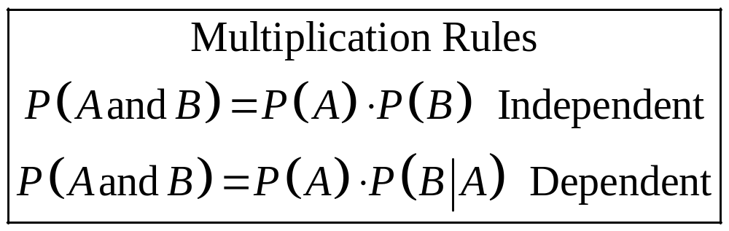
Multiplication Rules
Two events A and B are independent events if the fact that A occurs does not affect the probability of B occurring.

Slide 3
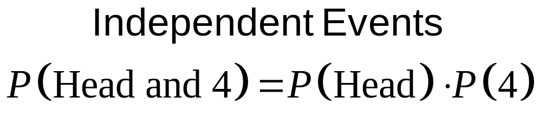
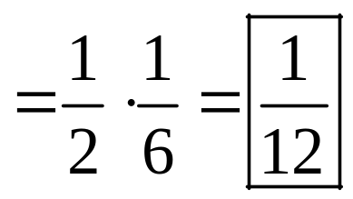
Example: Tossing a Coin
A coin is flipped and a die is rolled. Find the probability of getting a head on the coin and a 4 on the die.

Slide 4
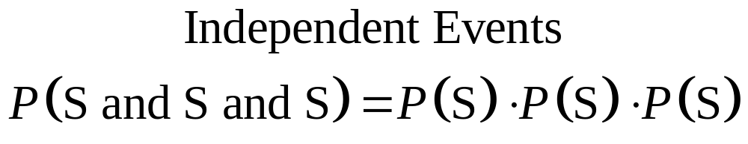
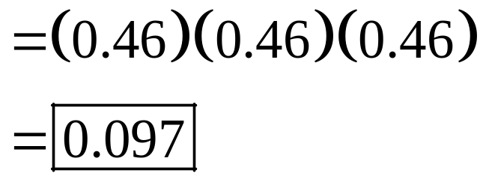
Example : Survey on Stress
A Harris poll found that 46% of Americans say they suffer great stress at least once a week. If three people are selected at random, find the probability that all three will say that they suffer great stress at least once a week.

Slide 5
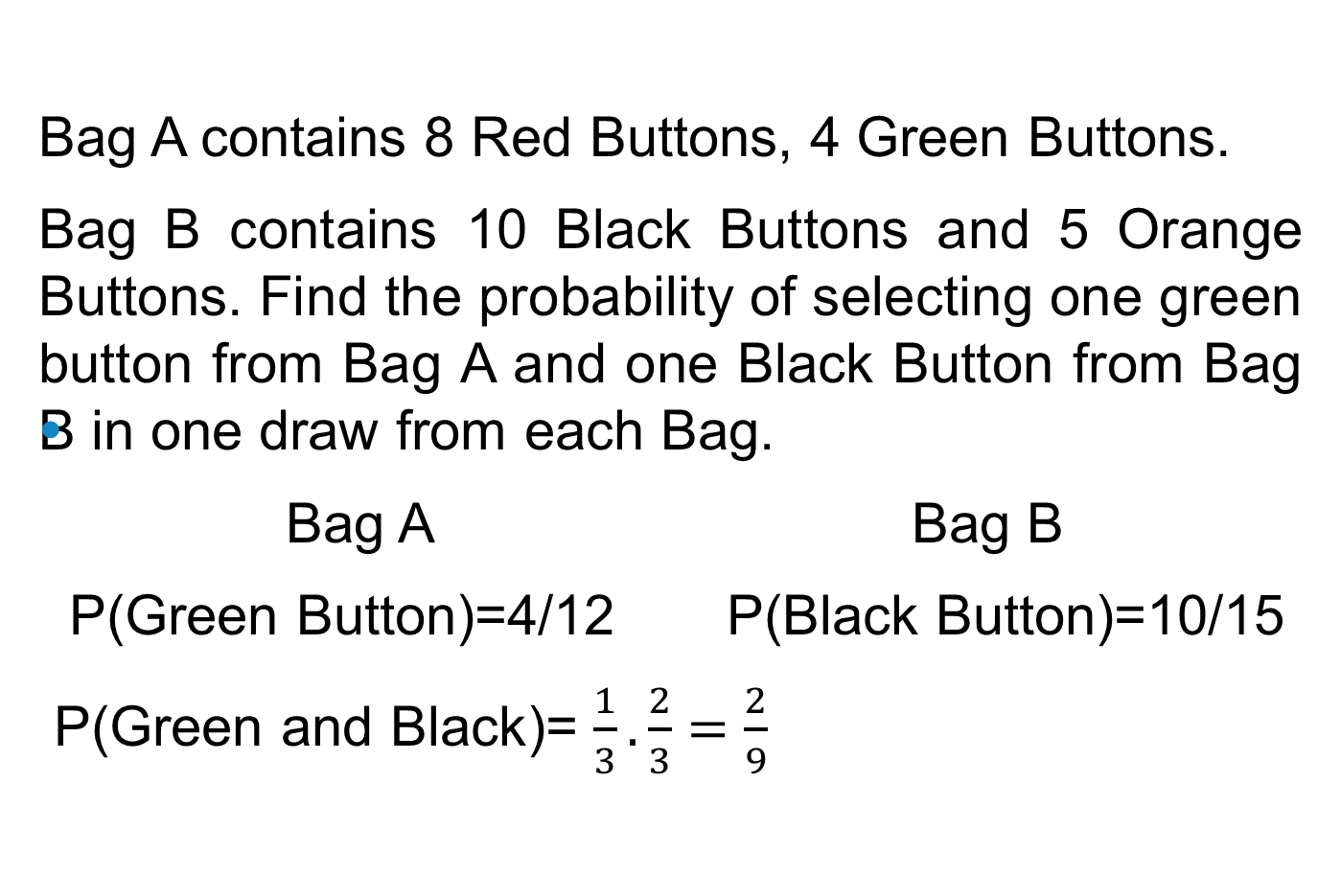
Buttons Example

Slide 6
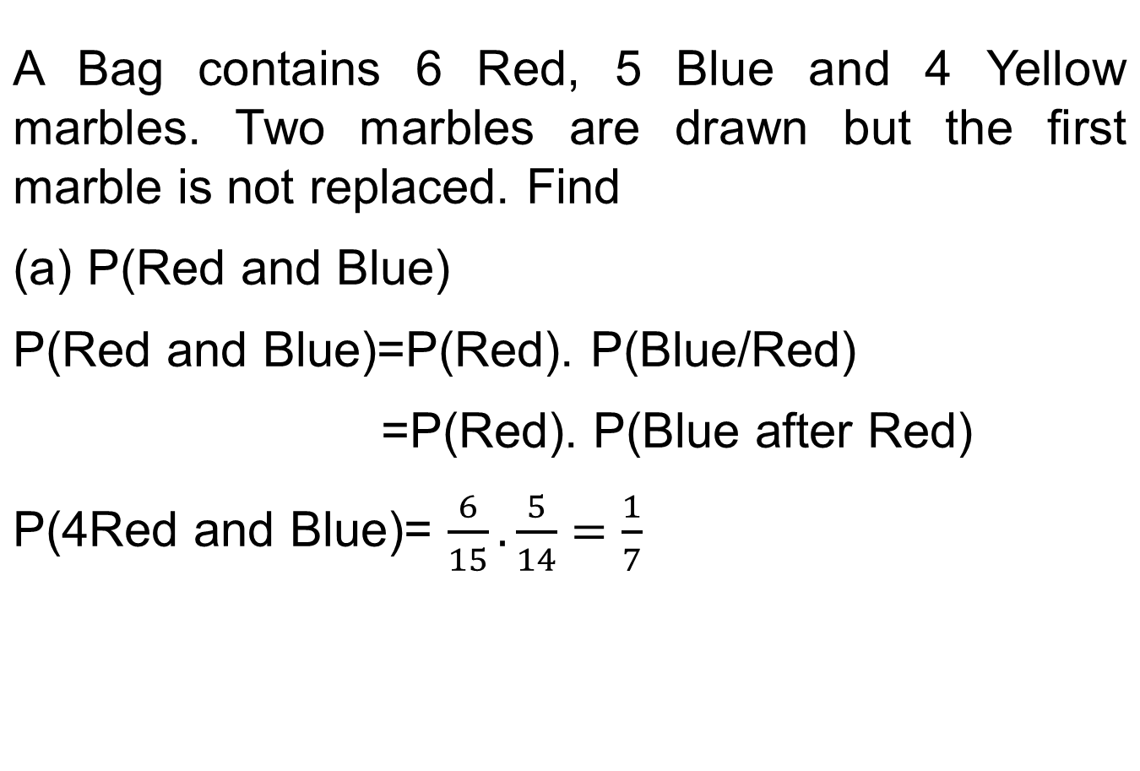
Marbles Example

Slide 7
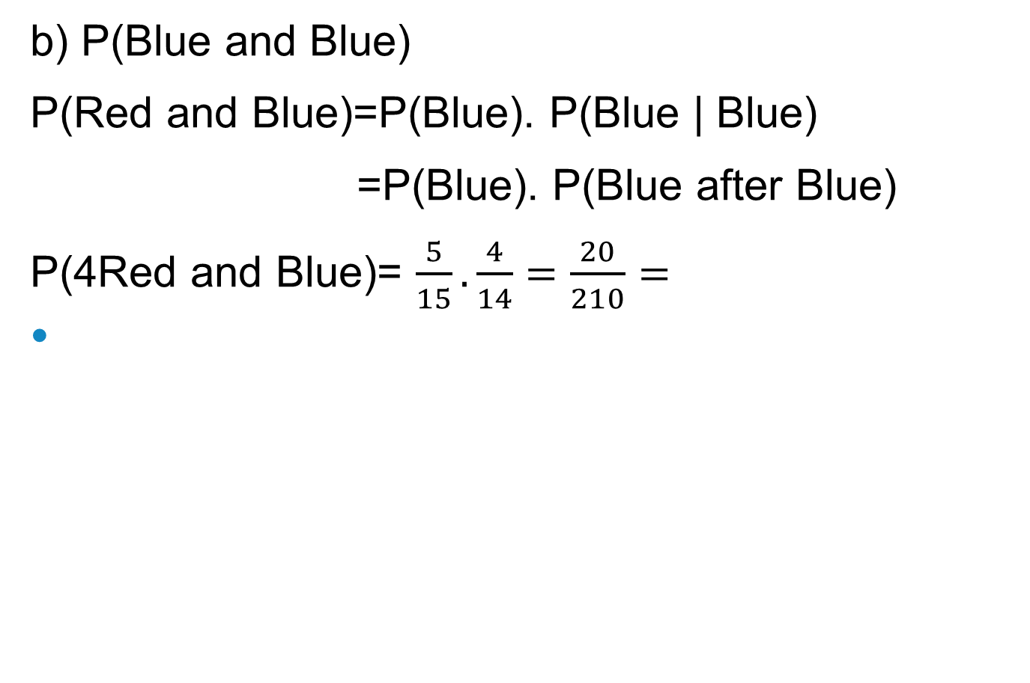
Marbles Example

Slide 8
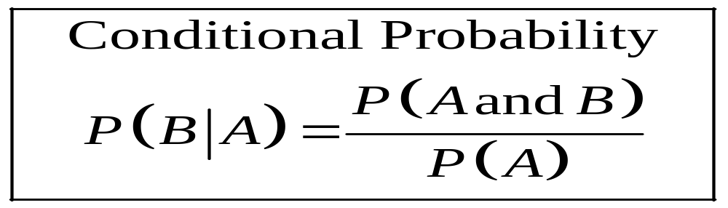
Conditional Probability
Conditional probability is the probability that the second event B occurs given that the first event A has occurred.

Slide 9
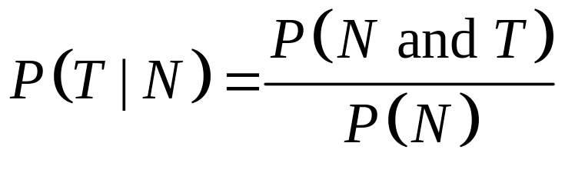
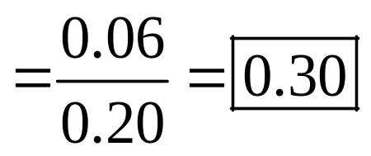
Example: Parking Tickets
The probability that Sam parks in a no-parking zone and gets a parking ticket is 0.06. The probability that Sam has to park in the no-parking zone is 0.20. On Tuesday, Sam arrives at school and has to park in a no-parking zone. Find the probability that he will get a parking ticket.
N = parking in a no-parking zone
T = getting a ticket

Slide 10
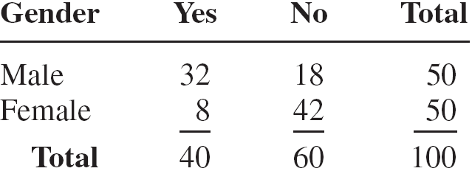
Example: Women in the Military
A recent survey asked 100 people if they thought women in the armed forces should be permitted to participate in combat. The results of the survey are shown.

Slide 11
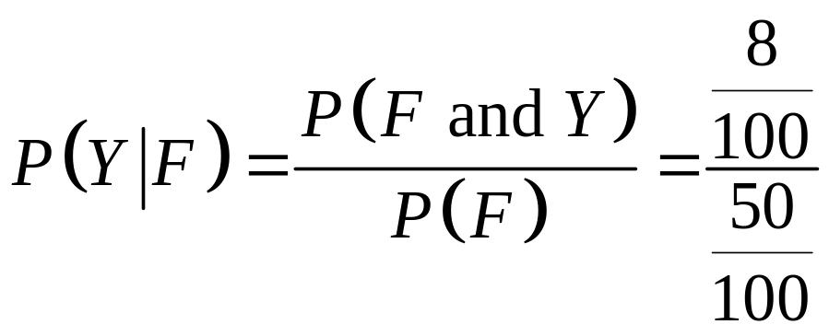
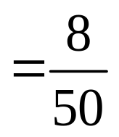
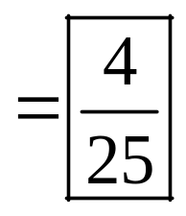
Find the probability that the respondent answered yes (Y), given that the respondent was a female (F).

Slide 12
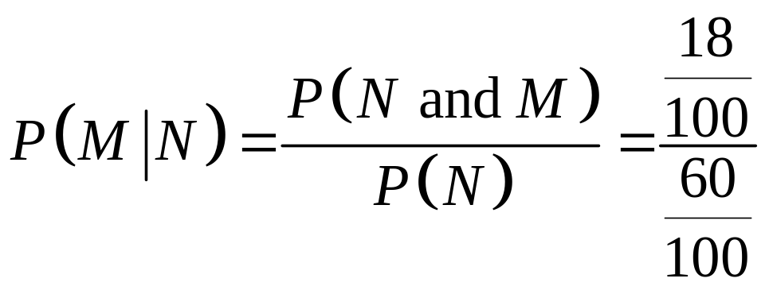
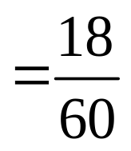
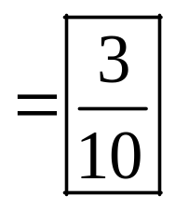
.
  (b). Find the probability that the respondent was a male (M), given that the respondent answered no (N).

Slide 13
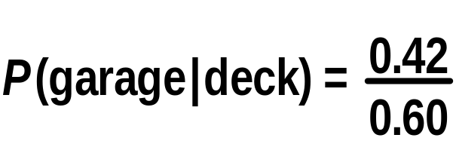

EXAMPLE
In Rolling Acres Housing Plan, 42% of the houses have
a deck and a garage; 60% have a deck. Find the
probability that a home has a garage, given
that it has a deck.

Slide 14
EXAMPLE
 | Corporation | Government | Individual
U.S. | 70,894 | 921 | 6129
Foreign | 63,182 | 104 | 6267
Consider this table concerning utility
patents granted for a specific year.
Select one patent at random.
What is the probability that it is a
foreign patent, given that it was
issued to a corporation?
What is the probability that it
was issued to an individual,
given that it was a U.S. patent?

Slide 15
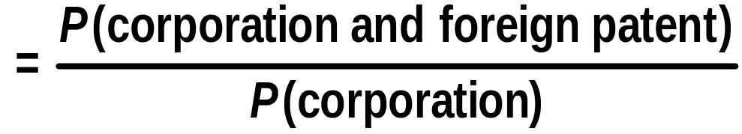
 | Corporation | Government | Individual
U.S. | 70,894 | 921 | 6129
Foreign | 63,182 | 104 | 6267
What is the probability that it is a
foreign patent, given that it was
issued to a corporation?
P(foreign patent | corporation)

Slide 16
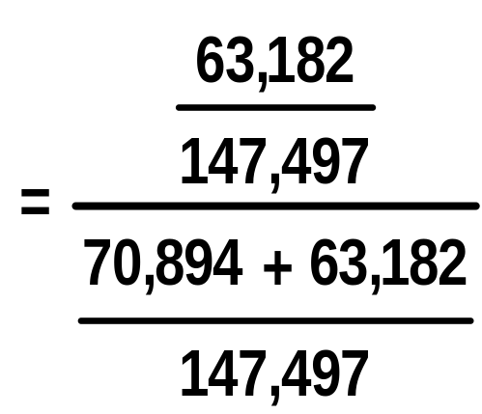
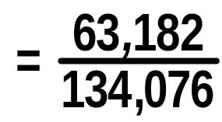
 | Corporation | Government | Individual
U.S. | 70,894 | 921 | 6129
Foreign | 63,182 | 104 | 6267
P(foreign patent | corporation)

Slide 17
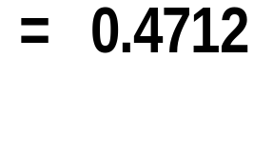
 | Corporation | Government | Individual
U.S. | 70,894 | 921 | 6129
Foreign | 63,182 | 104 | 6267
P(foreign patent | corporation)

Slide 18
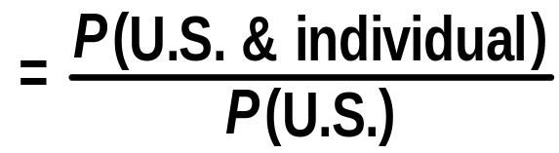
 | Corporation | Government | Individual
U.S. | 70,894 | 921 | 6129
Foreign | 63,182 | 104 | 6267
What is the probability that it was
issued to an individual, given that
it was a U.S. patent?
P (individual | U.S.)

Slide 19
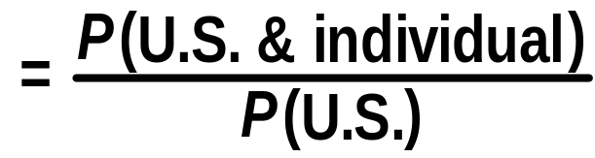
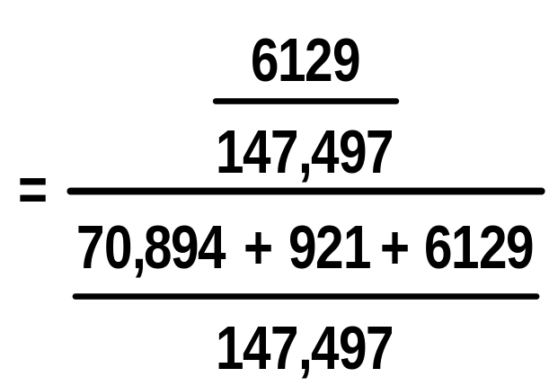
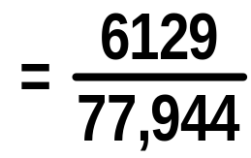
 | Corporation | Government | Individual
U.S. | 70,894 | 921 | 6129
Foreign | 63,182 | 104 | 6267
P(individual | U.S.)

Slide 20
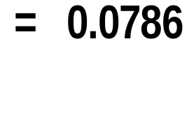
 | Corporation | Government | Individual
U.S. | 70,894 | 921 | 6129
Foreign | 63,182 | 104 | 6267
P(individual | U.S.)

Slide 21
Random Variables and Probability Distribution
In a statistical experiment, it is often very important to allocate numerical values to the outcomes.
Example:
· Experiment: testing two components. (D=defective, N=non-defective)
· Sample space: S={DD,DN,ND,NN}
· Let X = number of defective components when two components are tested.
· Assigned numerical values to the outcomes are:

Slide 22
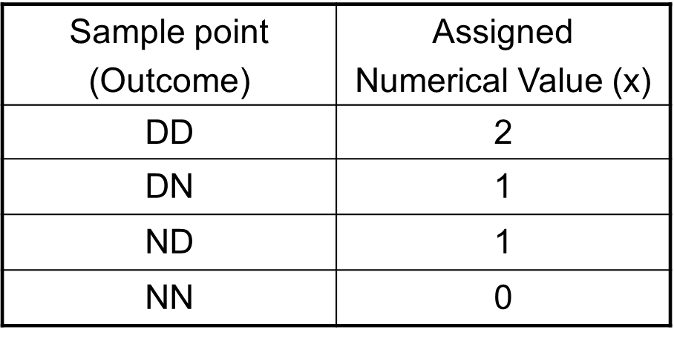
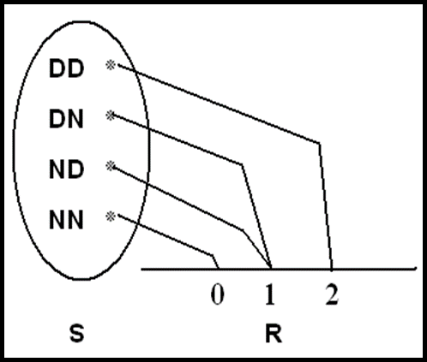
Random variables and Probability Distribution

Slide 23
Random variables and Probability Distribution
Example:
· Experiment: tossing a coin 2 times independently.
· H= head , T=tail
· Sample space: S={HH, HT, TH, TT}
· · Let X= number of heads
Sample Point Outcome | Numerical Value | Probability Distribution
DD | 2 | 2/4
DN | 1 | 1/4
ND | 1 | 1/4
NN | 0 | 0/4

Slide 24
Thank you

